Slide 1
Introduction to Linux
Srikanth Sureddy, Senior Escalation Engineer, EEE

Slide 2
System Structure
Shell
Linux Kernel
You (user)
ssh,telnet,ftp
System Hardware
Hierarchical
Directory structure
/
/bin
/media
/dev
/etc
/home
/boot
/tmp
/usr
/var
/lost+found
/misc
/opt
/sbin
/lib
2
Notes:
The structure of the Linux system has essentially 3 main components, the kernel, the shell and the hierarchical directory structure.
Instructions are sent to the Kernel from the shell it then enlists hardware resources
Kernel is responsible for controlling hardware and resources Such as Disk IO devices, memory but also controls process and file management
The Shell is a user program or environment that interacts with Kernel –It’s where the users run tools and utilities. It’s not part of the kernel. Some of the shells that are available are bash, c, ksh- check your current shell with the ps command.
The Directory structure is hierarchical where each dir contains files or dirs.

Slide 3
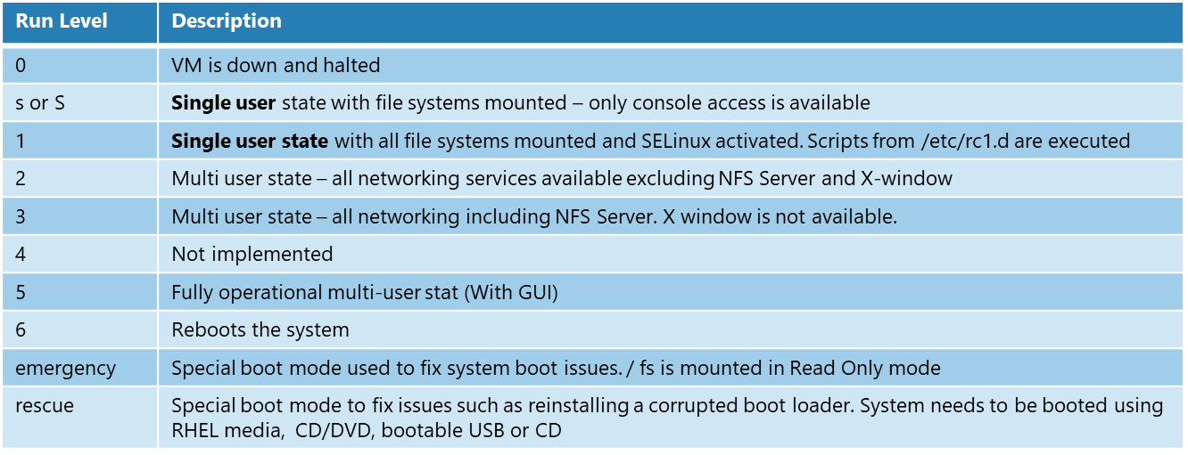
Shutdown and Boot
Linux supports various Run Levels rc (run control) levels
Run Levels for Centos
Notes:
Linux Run Levels are similar to the choices available in Windows system such as “Safe Mode", "Safe Mode with Networking", "Command Prompt“.
The difference is that in Linux, the Run Level is invoked by the sys Admin – a change in the RL does not occur due to a system coming down in an unclean state.
At each Run Level different programs/scripts will be executed independently of another RL. The scripts that are executed at each RL are configurable. RL’s are useful for maintenance and recovery procedures.
A good example to understand RLs from this chart is to compare RL 3 to RL 5. RL 3 does not have the X windows subsystem started and hence no GUI, Headless Mode. Server Room scenario. In Azure our VM’s run in RL 3 by default. To change the RL you must logged in as a privileged account.

Slide 4
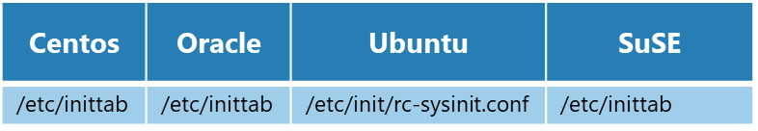
Comparative Run Levels
# Default runlevel. The runlevels used are:
# 0 - halt (Do NOT set initdefault to this)
# 1 - Single user mode
# 2 - Multiuser, without NFS (The same as 3, if you do not have networking)
# 3 - Full multiuser mode
# 4 - unused
# 5 - X11
# 6 - reboot (Do NOT set initdefault to this)
#
id:3:initdefault:
Notes:
The configuration file that defines the default RL is /etc/inittab with Ubuntu being the exception. In this example our VM will start at RL 3. No X

Slide 5
Shutdown and Boot - Run Control Levels
Verify current and previous RC levels
who –r , runlevel
Change RC levels
init #
telinit #
...(where # is a run level value 0 – 6)
shutdown
halt
reboot
poweroff
Notes:
To verify the RL you can use commands like who –r and runlevel , these will display current and previous RL
To change the RL you need to be a privileged account , various commands are available to do this.
init and telinit take values between 0 thru 6, Shutdown is the cleanest method to inform users of system coming down as it can broadcast a message to all connected users. Also can specify a time for the shutdown.
Other commands powerff = stopped , “halt” will turn the VM off and in the Azure Mgmt Portal,

Slide 6
Shutdown and Boot - Boot Sequence
External devices are powered up
The system is powered on
Power On Self Test (POST) on hardware is started by the System BIOS (Basic Input/Output System)
BIOS finds the boot device and loads a boot loader program known as GRUB
GRUB default boot loader usually found on the MBR (Master Boot Record) on the first sector of the boot device.
The GRUB program is loaded
GRUB calls the kernel which is a compressed file
The Kernel is responsible for initializing and configuring the HW. It loads the necessary modules and then initiates the kernel swapper process Kswapd, starts up any RAID and LVM virtual devices, creates a root device and mounts the root FS with read-only permissions on /
The Kernel sends a signal for the init command to start from the ramdisk and subsequent control is transferred to the init process.
Initialization commences with the init process which always has a PID of 1
root 1 0 0 Apr27 ? 00:00:00 init [3]
The default run level is defined in /etc/inittab , Init
The script /etc/rc.d/rc.sysinit is called by the init daemon. The rc.sysinit script will perform configuration tasks such as initializing hardware clock, loading kernel modules, configuring kernel parameters, setting the hostname, remounting root fs in read/write mode, checking and mounting local file systems, activating disk quotas, starting local swap spaces and activating SELinux
The /etc/rc.d/rc script is then executed and calls all startup scripts required for the system to come up to the default run level
The final task is for init to run the /etc/rc.d/rc.local script this spawns getty messages which display the login prompt
Notes:
The steps are numerous for a system boot.

Slide 7
Kernel Version
Kernel Version
uname –r
2.6.32-431.5.1.el6.x86_64
cat /proc/version
Linux version 2.6.32-431.5.1.el6.x86_64 (mockbuild@c6b10.bsys.dev.centos.org) (gcc version 4.4.7 20120313 (Red Hat 4.4.7-4) (GCC) ) #1 SMP Wed Feb 12 00:41:43 UTC 2014
rpm –q kernel
kernel-2.6.32-431.el6.x86_64
kernel-2.6.32-431.3.1.el6.x86_64
kernel-2.6.32-431.5.1.el6.x86_64
Notes:
To verify the running version of the kernel you can use one of 2 commands (uname prints system Information, try it with –a to see all information) Run with –o shows the OS as GNU/Linux or check the contents of the file /proc/version
rpm to query which kernels are installed in the VM / GRUB could be updated to run another Kernel

Slide 8
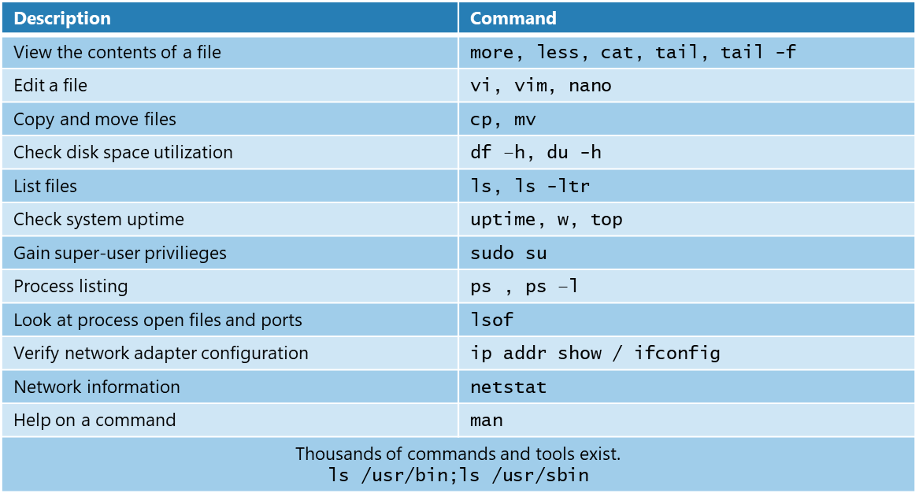
Basic Linux Commands
Notes:
Review of some basic commands
nano most intuitive for new Linux users
du –h will display current and recursive disk utilisation in MB displaying a total at the bottom
ps ,sleep 10; ps ;ps -l , csh, ps -l
id
runlevel;init 5
sudo su - root -c "init 5”
runlevel
sudo su - root -c "cat /etc/sudoers.d/waagent"

Slide 9
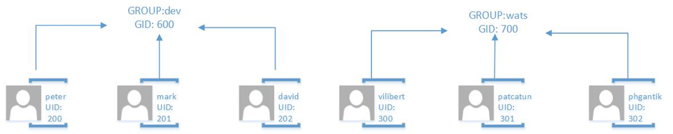
User and Group Management
Users of a *nix system are stored in /etc/passwd
Encrypted passwords stored in /etc/shadow
Groups are stored in /etc/group
Groups are added with groupadd
Users are added with useradd
Local versus Network Authentication
Notes:
Users and Groups are stored in flat text files with encrypted pw in /etc/shadow
For larger deployments (many users / or Linux desktops) centralized user admin/Authentication can be achieved with Ldap (OpenLdap) or NIS Maps

Slide 10
User and Group Management
groupadd -g 600 dev
useradd -d /home/peter -g 600 –G 600 -c "dev account for peter" -m -u 200 peter
useradd -d /home/mark -g 600 –G 600 -c "dev account for mark" -m -u 201 mark
groupadd -g 700 wats
useradd -d /home/vittorio -g 700 -G 700 -c "WATS account for vittorio" -m -s /bin/ksh -u 300 vilibert
useradd -d /home/patrick -g 700 -G 700 -c "WATS account for patrick" -m -u 301 patcatun
useradd -d /home/kiran -g 700 -G 600 -c "WATS account for kiran" -m -s /bin/csh -u 302 kiran
tail -5 /etc/passwd
peter:x:200:600:petes dev account:/home/peter:/bin/bash
mark:x:201:600:marks dev account:/home/mark:/bin/bash
patcatun:x:301:700:WATS account for patrick:/home/patrick:/bin/bash
vilibert:x:300:700:WATS account for vittorio:/home/vittorio:/bin/ksh
kiran:x:302:700:WATS account for kiran:/home/kiran:/bin/csh
tail -2 /etc/group
dev:x:600:peter,mark,kiran
wats:x:700:patcatun,vilibert
Notes:
Explain the switches. The GID and UID concepts, possible shell options taken from /etc/shells
Accounts can have primary and secondary groups – example account kiran

Slide 11

Files and Permissions
A directory is a file, a program is a file, a log is a file.
Files have permissions for Owner, Group, and Other
-rwxrw-r--. 1 mark dev 1385 Jan 15 10:29 /home/mark/test.sh
Permissions Owner Group Filename
7 6 4
Permissions are made up of 3 bit fields
Each bit has a numeric value that reads from left to right
rwx = 421 in the above example, numeric permissions for the file are 7 6 4 = (4+2+1, 4+2, 4)
1st 3 bits define permission for the Owner of the file (Possible owners are stored in /etc/passwd)
2nd 3 bits define permissions for the Group members (Groups are defined in /etc/group)
3rd 3 bits permission for Others
r=read, w=write, x=execute
ls -ltr | grep ^d
d – display all files in directory that Start with d - denotes a directory
Notes:
This file is owned by user Mark and has RWX permissions
The group dev also has RW on this file (any memember for dev can RW the file) so from previous slide remember Kiran was in GROUP dev as a secondary group – he has RW

Slide 12
Service (Process) Management
What’s a Linux Service?
Processes/Daemons can be started via service commands
WA Linux Agent is configured as a service
Centos, Oracle, SuSE - waagent
Ubuntu – walinuxagent
service waagent start
service waagent status
service waagent stop
Notes:
A Linux service is an application (or set of applications) that runs in the background waiting to be used
Example could by MySQL, sshd or a httpd webserver

Slide 13
Processes
If you know service name use status option to verify if it’s up
service waagent status
waagent (pid 1418) is running...
The underlying Linux daemon is seen with the ps command
ps -ef | grep -i waa | grep -v grep
root 1418 1 0 Jan27 ? 00:00:17 python /usr/sbin/waagent –daemon
UID PID PPID C STIME TTY TIME CMD
Notes:
ps – reports a snapshot of the current processes
-e = all , -f full format listing

Slide 14
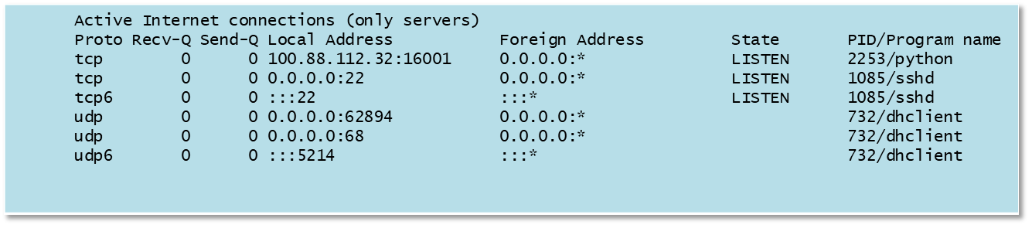
Processes and Ports
Verify if a daemon/process is listening on a port
lsof (List Open Files)
lsof -p 1418 | grep -i listen
lsof -i -n -P | grep -i 1418
Check for all Listening PORTS on a VM
netstat –tulpn (or use lsof | grep –i listen)
Notes:
lsof will list all the files the process has opened. This could be log files, libraries, charachter devices

Slide 15
Software (Package) Management
Software packages are managed with the “rpm” or “dpkg” command
These install 1 package and not dependencies
rpm (centos, oracle, SuSE)
dpkg (ubuntu)
rpm Originally stood for “Red Hat Package Manager”, now stands for “RPM Package Manager”
dpkg – Debian package manager
To install software and dependent packages :
yum install apache – Centos, Oracle (Yum – Yellowdog update modifier)
zypper install apache - SuSE
apt-get install apache - Ubuntu
rpm - Uses a Berkeley DB and is stored in /var/lib/rpm
dpkg – Uses /var/lib/dpkg
Notes:
A software package is a collection of files that can be installed onto the system.
Software can be managed with rpm or dpkg depending on the distro. It will however only install single packages and will not install any required SW like libraries or other programs.
Each distro has it’s own software tool to manage sw installation. The tools will look for software locations based on the configured sw repositories
Each distro has it’s own software tool to manage sw installation. The tools will look for software locations based on the configured sw repositories

Slide 16
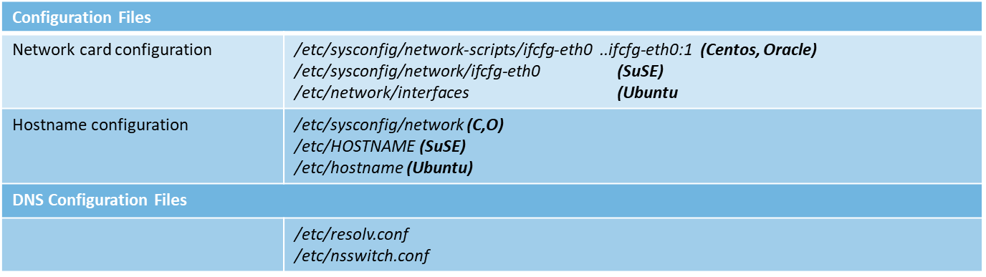
Basic Networking - Configuration Files
Notes:
Each Linux distro has a different location and file name to configure network interface card properties.
In Azure we currently support 1 NIC per VM and is by default eth0
In an on – prem Linux system it’s possible to have more than 1 NIC. They are usually numbered incrementally so 4 nics on a system would have the names of eth0, eth1, eth2 and eth3. In the scenario where multiple nics are present increased redundancy and greater bandwidth can be achieved by aggregation. This is also referred to as bonding or teaming
Typical information found in nic files include the device name, BOOTPROTO, (if static you specifiy an IPADDR) DHCP_HOSTNAME, ONBOOT
DNS configuration files are standard locations the resolv.conf defines which NAMESERVER to use for dns lookups whilst the nsswitch.conf defines the order in which lookups should occur, locally, /etc/hosts, DNS.

Slide 17
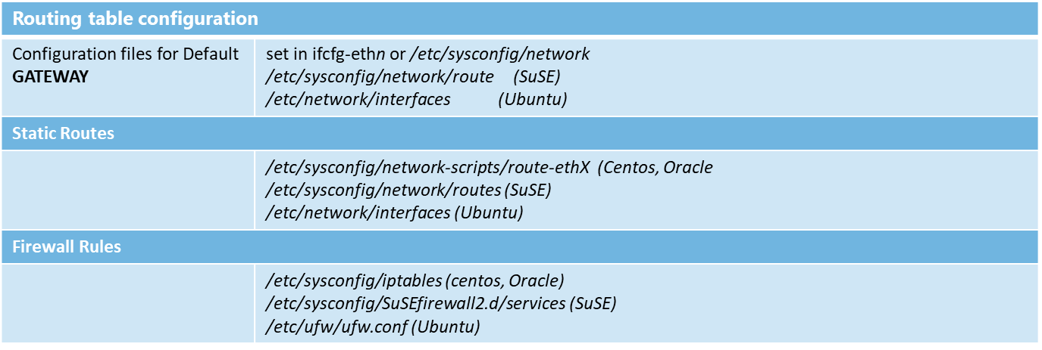
Networking Configuration Files (continued)
Notes:
The default GATEWAY is configurable with a static address or in the case of Azure it’s assigned by DHCP usually same subnet with but with an ip address of .1
Static routes can be added per system or per Interface allowing for traffic to be sent to different destinations
Firewall configurations are loaded into the kernel. These config files can be edited with GUI based tools but most admins will edit the file directly from the command line

Slide 18
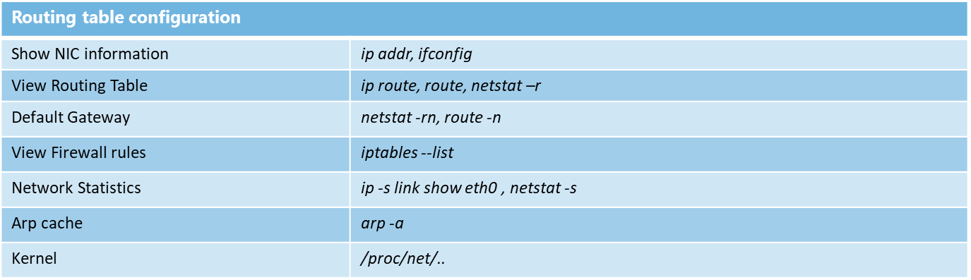
Viewing Network Information
Notes:
To look at the information regarding the network card you can use ip addr will display the nics , the IP’s associated, if IPV6 address is assigned, the MAC address if the card is up.
Routing rules (how a pkt gets from a node on network a to a node on network b) can be seen with various commands, I prefer netstat- rn it will display information on destination host/network and which Address/Gateway to use –
Manipulate the routing table with ip route add or ip route del commands
route del -net 169.254.0.0/16
Linux machines can act as basic routers if you change the value of net.ipv4.ip_forward = 0 to 1
Sent, rcv, or dropped pkts can be see with ip –s or netstat –s
/proc/net contains lots of kernel statistical and configuration information written out by the kernel for use by user-space programs

Slide 19
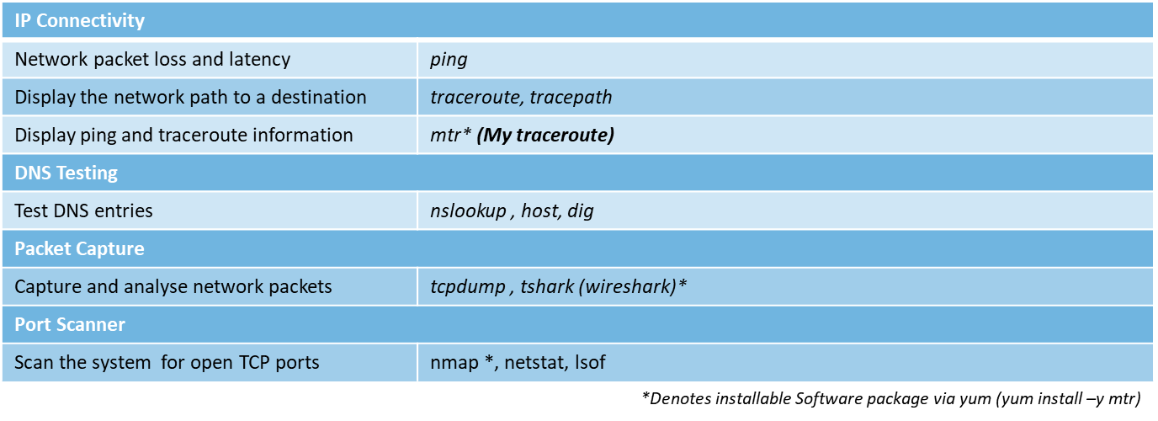
Network Diagnostic Tools
Notes:
Ping - send ICMP ECHO_REQUEST to network hosts
traceroute tracks the route packets taken from an IP network on their way to a given host. It utilizes the IP protocols time to live (TTL) field and attempts to elicit an ICMP TIME_EXCEEDED response from each gateway along the path
to the host.
traceroute - It traces path to destination discovering MTU along this path. It uses UDP port port or some random port. It is sim-ilar to traceroute, only does not not require superuser privileges
mtr combines the functionality of the traceroute and ping programs in a single network diagnostic tool.

Slide 20
Logs and Configuration Files
Configuration files
Majority of configuration files have an extension of .conf
Most of these files are located in /etc or subdir some in /usr/share
/etc/waagent.conf
/etc/logrotate.conf
/etc/httpd/conf/httpd.conf
Log files located in /var/log
/var/log/messages
/var/log/maillog
Log Rotation is achieved by a utility logrotate
Notes:
Logrotate is highly configurable allows you to state directives to rotate logs, retention period, should they be compressed, moved, and can also run post tasks on a rotate.

Slide 21
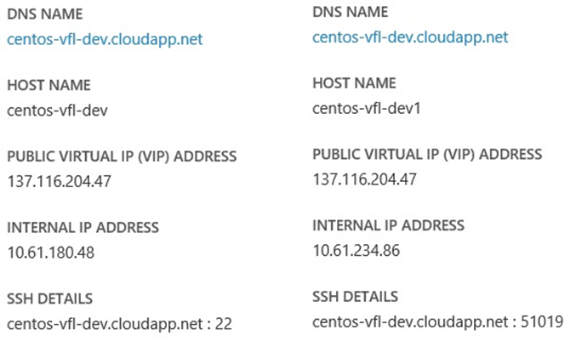
SSH Configuration
The ssh daemon allows connectivity into a Linux VM (Like RDP for Windows)
By default it listens for requests on port 22 (Configurable)
Configuration file /etc/ssh/sshd_config
VMs in same cloud service will have different ssh port
Notes:
ssh is a secure shell and data is encrypted between client and server
The configuration of having different ssh port values in a Cloud Service is configured via Azure Endpoints

Slide 22
Disk Partitions and File Systems
Disks can and are often subdivided into “partitions”
File systems are created on partitions and are mounted onto previously created directories also known as “mount points”
For file systems to persist mounting following a reboot, entries must be made into /etc/fstab
filesystem
/
/opt
/home
partition
/dev/sda1
/dev/sda2
/dev/sda3
disk
/dev/sda
Notes:
Traditionally Unix or Linux systems were partitioned so that Programs and binaries would be installed into separate partitions.
Advantages if a file system gets corrupted, the data outside that filesystem/partition may stay intact, minimizing data loss.
File systems can be mounted with different permissions

Slide 23
Disk Partitions and File Systems
MBR partitioning format is used to subdivide disks into partitions sdc1, sdc2, sdc3 and sdc4
Additional Partitions can be created converting a Primary into Extended Partition
Logical Partitions are then created on top of the extended
Storage Device:/dev/sdc
MBR
sdc5
sdc6
unused
P
P
P
P
L
E
L
E
sdc1
sdc2
sdc3
sdc4
sdc4
Partitions
P=Primary
E=Extended
L=Logical
Notes:
By default you can create 4 partitions on a disk But many more can be created by converting 1 Primary partition into an extended partition. You then create Logical partitions on the Extended Partition.

